Slide 1

Paper presentation - “Numerical simulation of urea based selective non-catalytic reduction
deNOx process for industrial applications
” - Baleta et al
Parth Hiren Shah
Roll No: 180122030

Slide 2
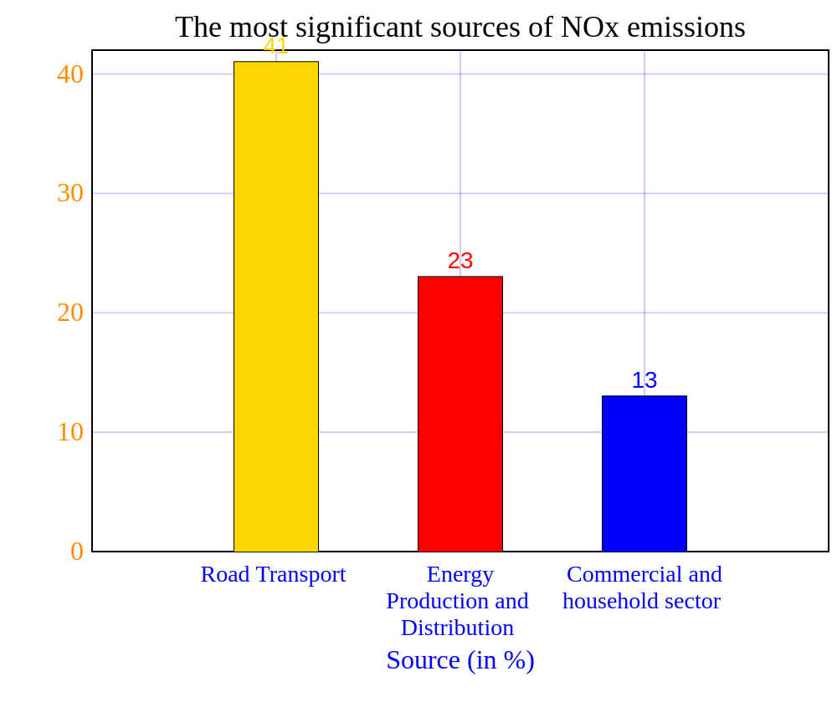
Introduction
NOx emissions are one of the main reasons behind global warming, contributing also to acid deposition and eutrophication of soil and water.
Methods to control NOx emissions can be categorised into avoiding creation of NOx and reduction of already created NOx.
Selective Non-Catalytic Reduction (SNCR) is one of the methods to reduce NOx to lower emissions. Unlike selective catalytic reduction (SCR) it doesn’t face any integrating issues, however SNCR gives lower denitrification efficiencies compared to SCR.

Slide 3
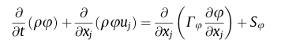
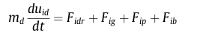
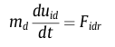
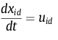
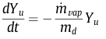
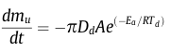
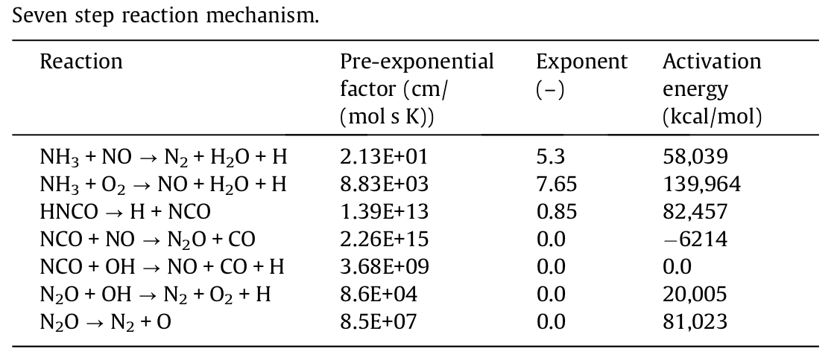
Mathematical Model
Injection of urea-water solution (UWS) into hot flue gases
solution of gas phase;
description of spray droplets motion inside the domain;
evaporation of urea-water solution droplets;
thermal decomposition of urea;
chemical reactions taking place in the gas phase;
accurate and computationally economical representation of turbulence.

Slide 4
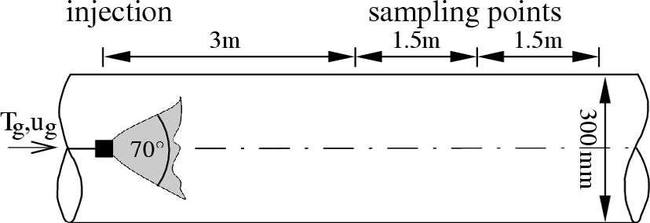
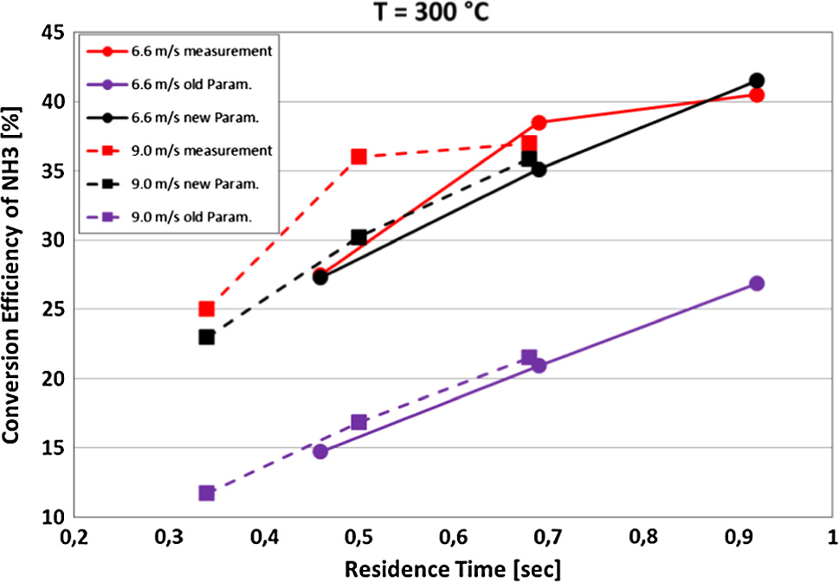
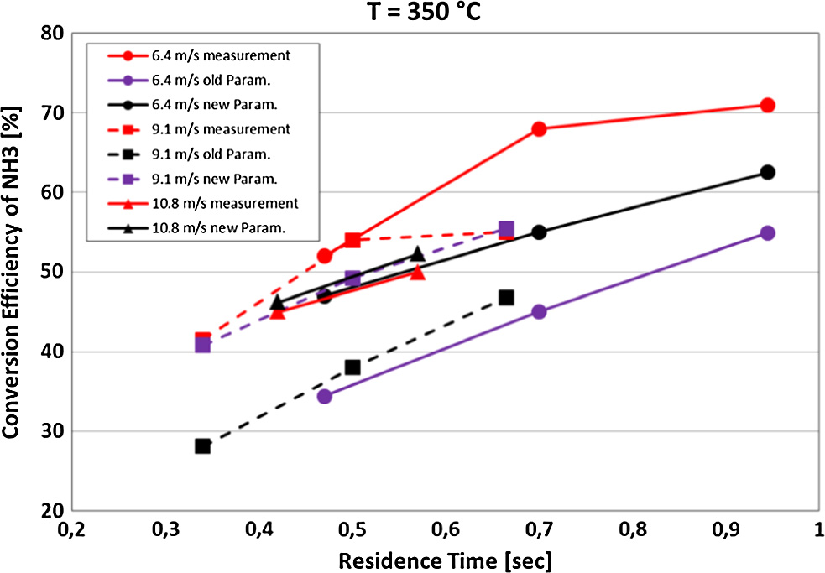
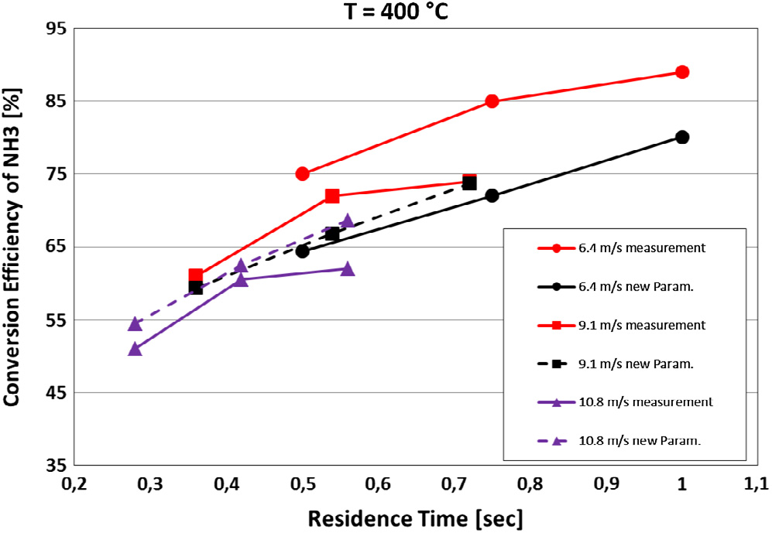
Kim’s case
Kim measured urea solution evaporation in hot exhaust gas to get values for NH3 conversion rates in SCR systems.
An evaporation model for spray; that can be tuned with two parameters (E4 & E5).
Outlet and inlet conditions
Turbulence model
Particle size distribution
New parameters show better agreement with experiment in all cases compared to the old ones.
Temperature
Gas Velocities, pressure, momentum, turbul
Entrance
Performed simulations justify usage of Rapid Mixing model for droplet evaporation.

Slide 5
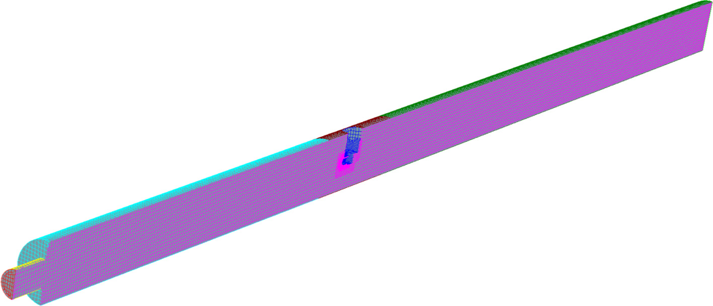
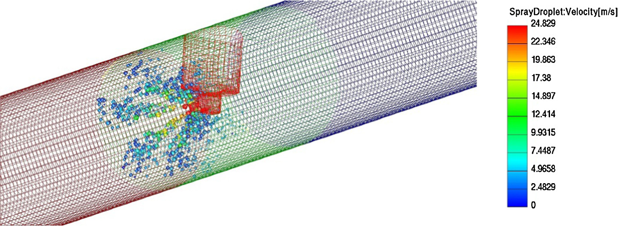
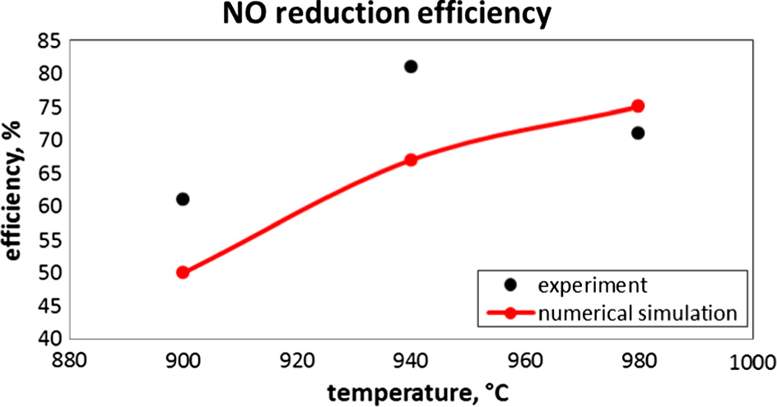
Simulation of Pipe reactor
The conditions were taken from the paper Experiment and computational fluid dynamics (CFD) simulation of urea-based selective non-catalytic reduction (SNCR) in a pilot-scale flow reactor.
Domain
Turbulence, momentum and energy
Cases (3) - inlet temperature
Injection of water
Velocity field
Temperature field
Water vapour concentration
Urea Thermolysis - HNCO and NH3
NO reduction
Increase in temperature
Case 1 and 2

Slide 6
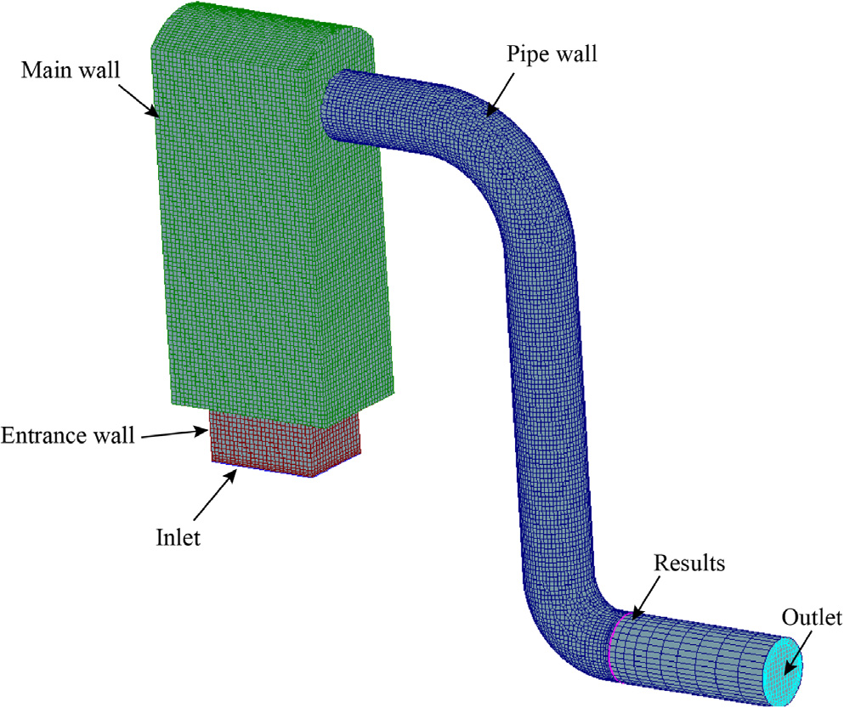
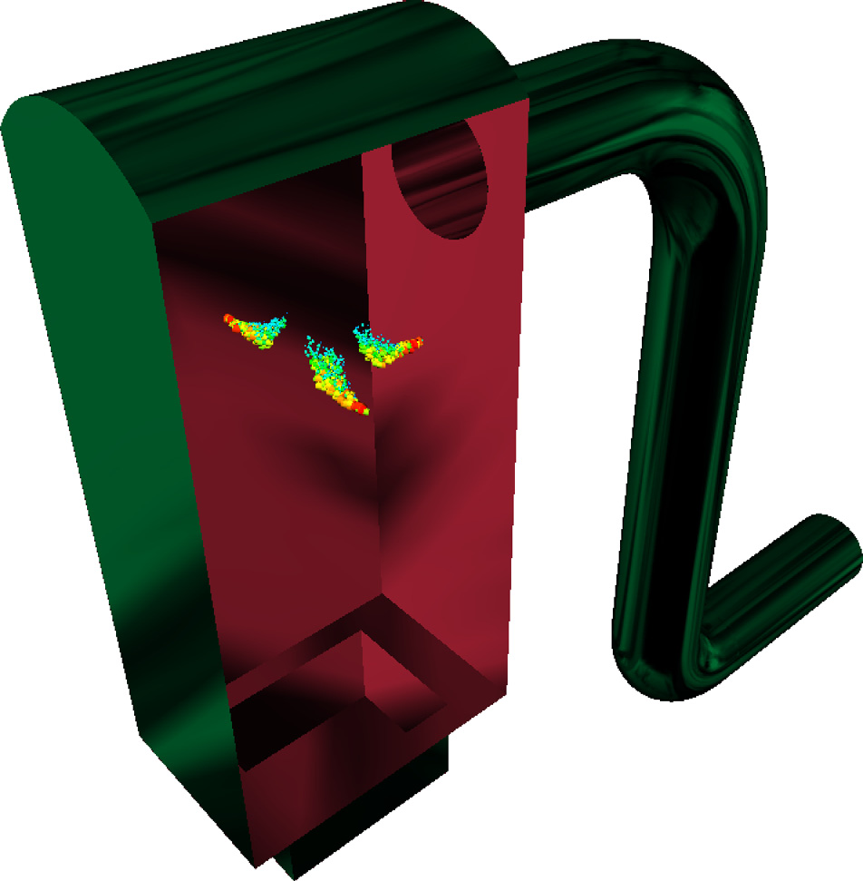
Simulation of Industrial incinerator
The conditions were taken from the paper Application of urea-based SNCR to a municipal incinerator: on-site test and CFD simulation.
Computational Domain
Inlet of gases
Boundary conditions
Droplet particle size distribution
Reaction kinetics

Slide 7
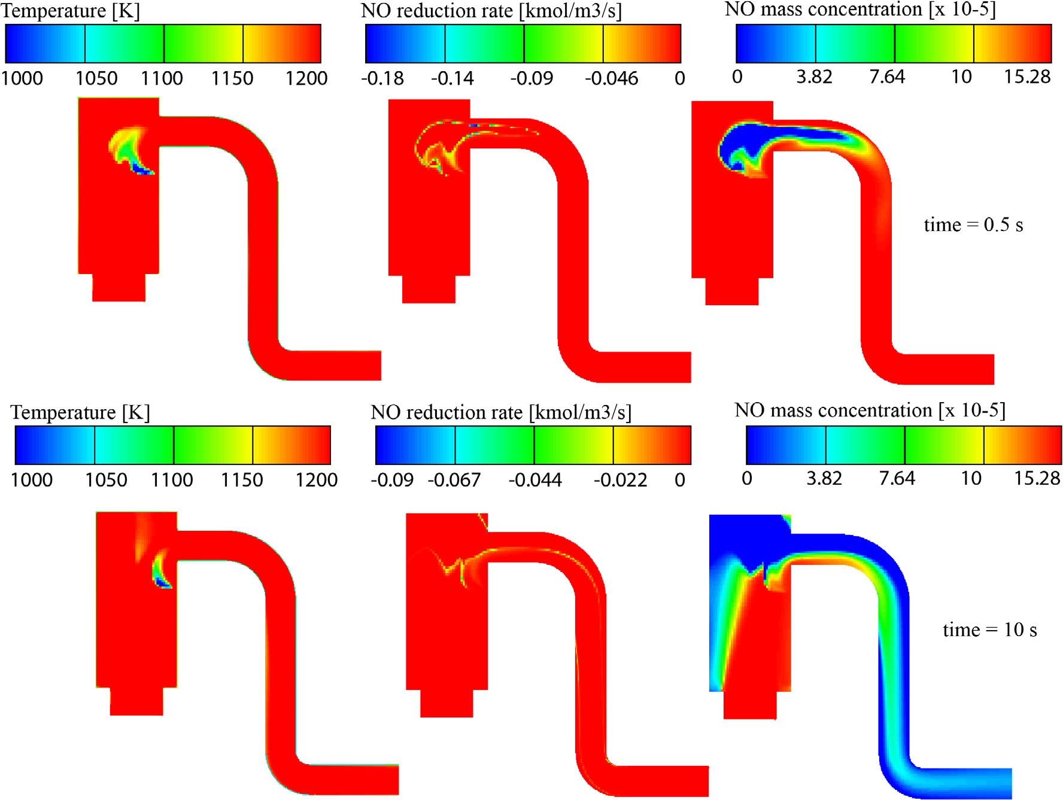
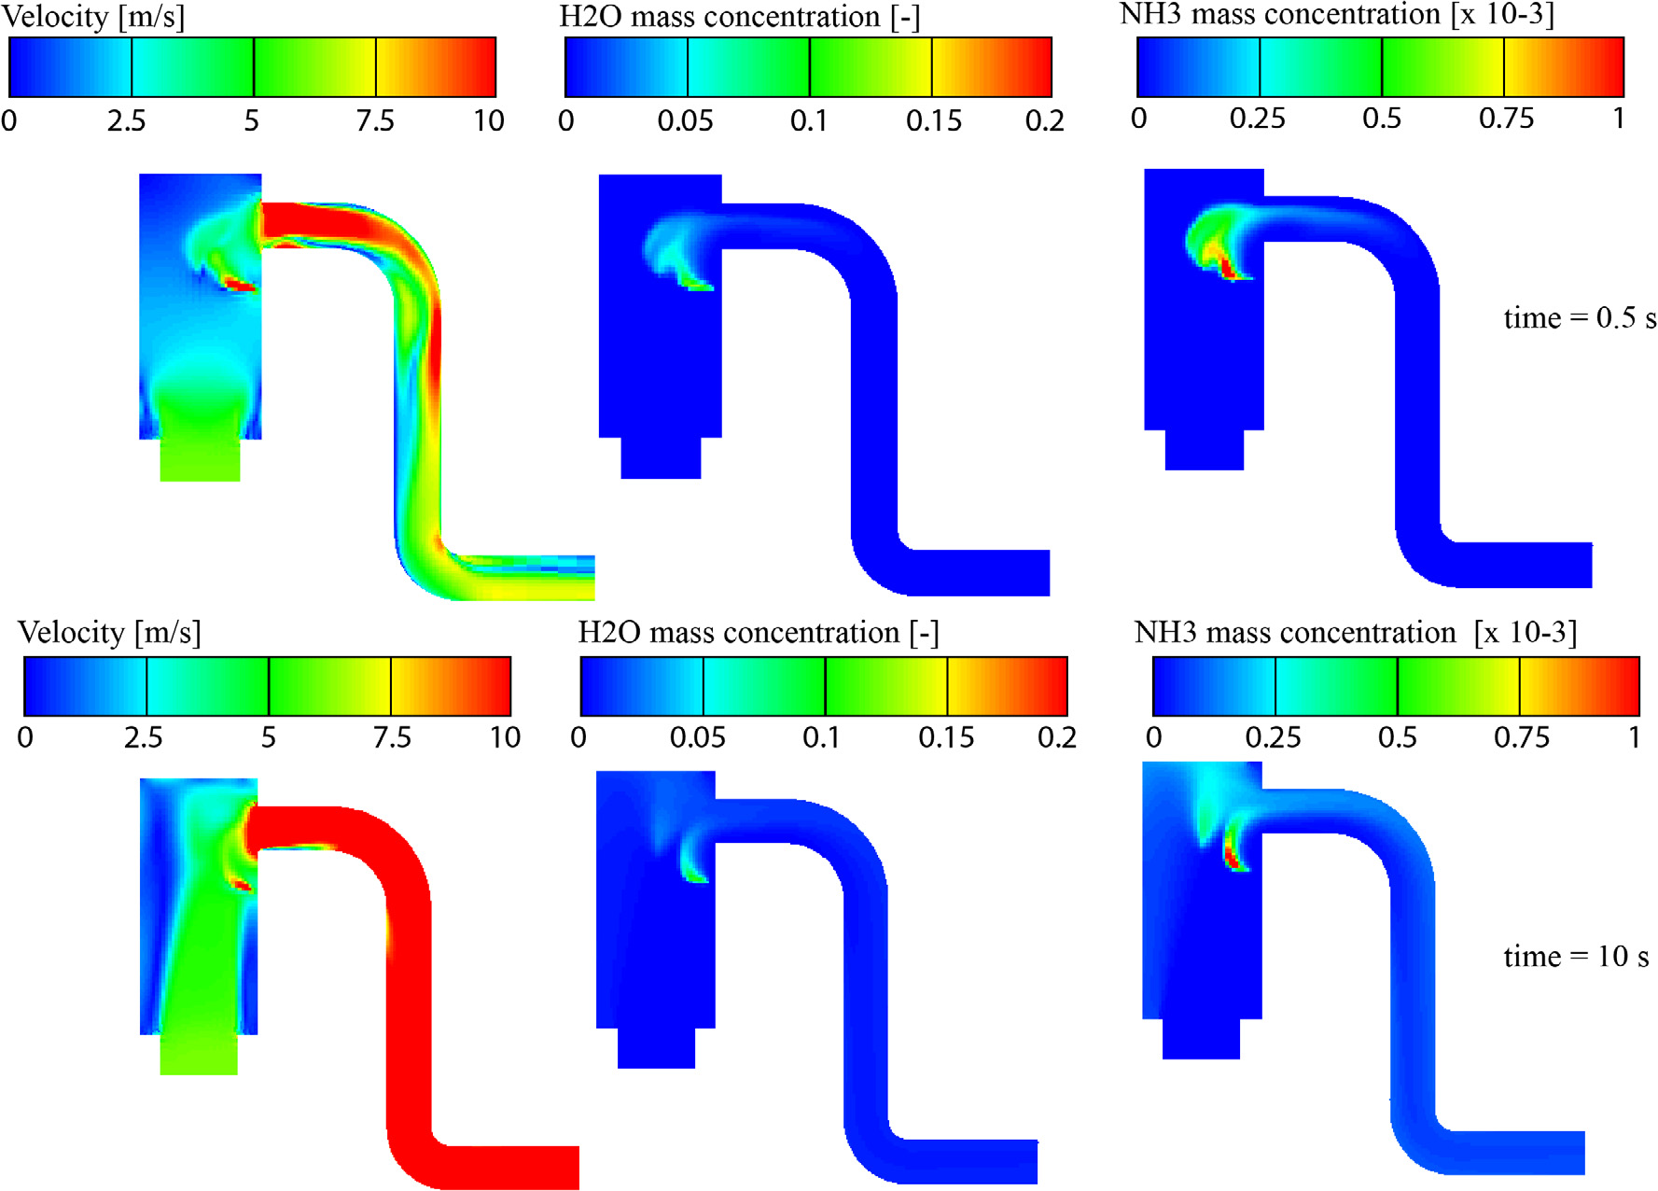
Simulation of Industrial incinerator

Slide 8
Conclusion
Validation and Parameterization on Kim’s Case
Application on an experimental case
Application in a large scale incinerator SNCR process
Thank You.

